Slide 1
WHO CREATED ?
Initially, Andy Rubin founded Android Incorporation in Palo Alto, California, United States in October, 2003.
In 17th August 2005, Google acquired android Incorporation. Since then, it is in the subsidiary of Google Incorporation.
The key employees of Android Incorporation are Andy Rubin, Rich Miner, Chris White and Nick Sears.

Slide 2
What is Android?

Slide 3
Android is a software package and linux based operating system for mobile devices such as tablet computers and smartphones.
It is Stack of Softwares such as Operating system , Middle Ware and Key applications.

Slide 4
It is developed by Google
later the OHA (Open Handset Alliance).
Java language is mainly used to write the android code even though other languages can be used.

Slide 5
OHA ?????
It's a consortium of 84 companies such as google, samsung, AKM, synaptics, KDDI, Garmin, Teleca, Ebay, Intel etc.
It was established on 5th November, 2007, led by Google.
It is committed to advance open standards, provide services and deploy handsets using the Android Platform.

Slide 6
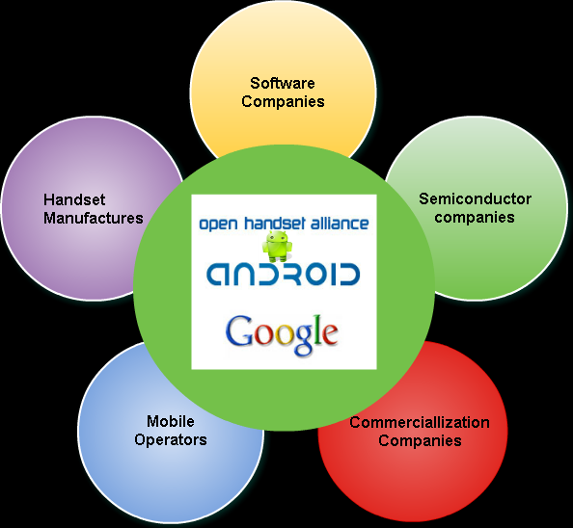
OPEN HANDSET ALLIANCES

Slide 7
Features of Android
It is open-source.
Anyone can customize the Android Platform.
There are a lot of mobile applications that can be chosen by the consumer.

Slide 8
It provides many interesting features like weather details, opening screen, live RSS (Really Simple Syndication) feeds etc.
It provides support for messaging services(SMS and MMS), web browser, storage (SQLite), connectivity (GSM, CDMA, Blue Tooth, Wi-Fi etc.), media, handset layout etc.

Slide 9
Categories of Android applications
Entertainment
Tools
Communication
Productivity
Personalization
Music and Audio
Social
Media and Video
Travel and Local etc.

Slide 10
History of Android
Version | Codename | API
1.5 | Cupcake | 3
1.6 | Donut | 4
2.1 | Eclair | 7
2.2 | Froyo | 8
2.3 | Gingerbread | 9 and 10
3.1 and 3.3 | Honeycomb | 12 and 13
4.0 | Ice Cream Sandwitch | 15
4.1, 4.2 and 4.3 | Jelly Bean | 16, 17 and 18
4.4 | KitKat | 19

Slide 11
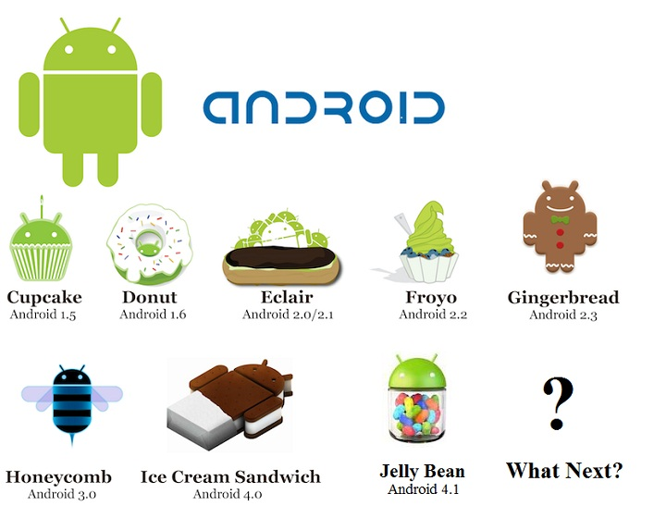

Slide 12
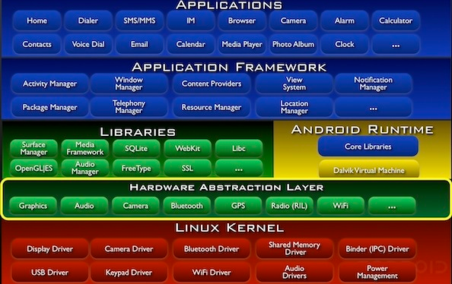
ARCHITECTURE

Slide 13
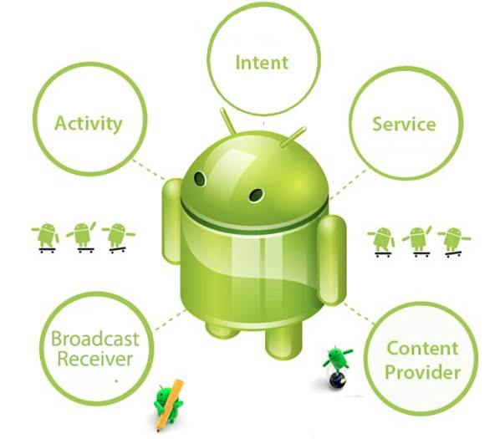
Android Core Building Blocks

